Slide 1
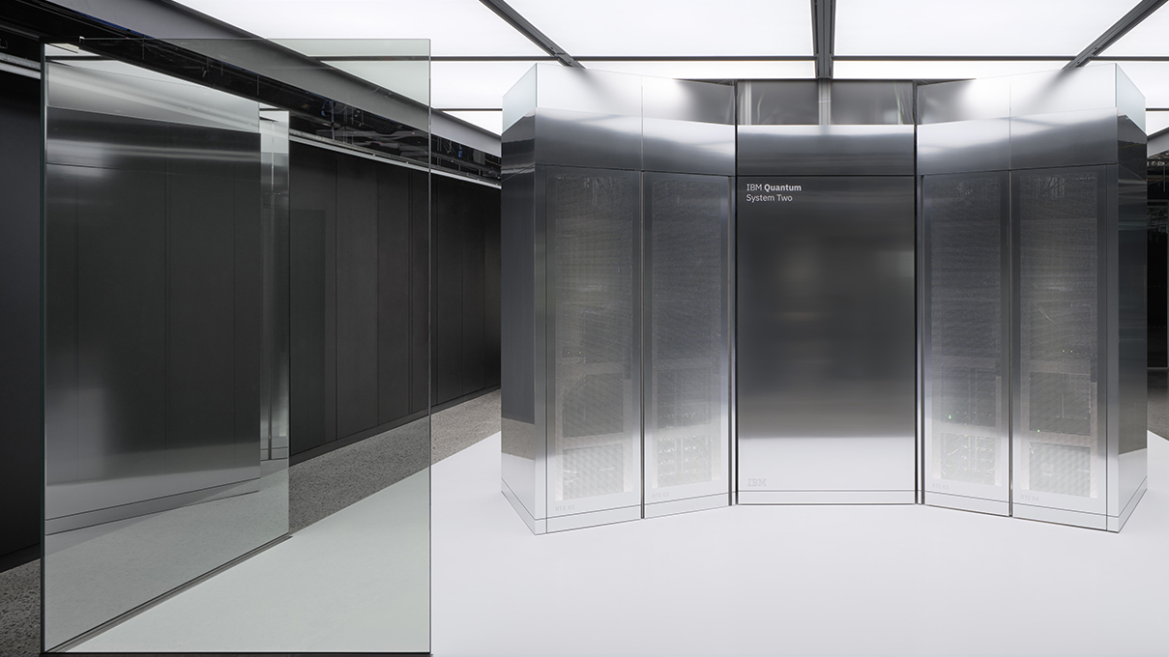
Intro to Quantum Computing
By Nole Stites
Notes:
Get out scratch paper and something to write with.

Slide 2
Lecture Content
Complexity and Probability Review
Introduction to the Quantum Bit
Quantum Gates
Quantum Circuits and Complexity
Quantum Mechanics

Slide 3
Complexity and Probability Review
Notes:
I am going to dabble a little in complexity theory during this lecture as well.

Slide 4
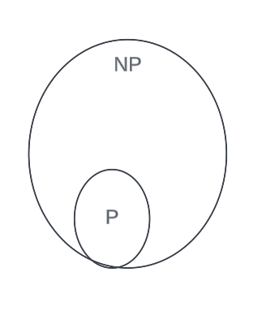
Class P and NP
P (Polynomial)
: the class of problems solvable by a Turing machine in polynomial time
ex: Searching for an item in a linked list
NP (Non-Deterministic Polynomial)
: the class of decision problems for which, if the answer is yes, then there is a polynomial-size proof of the fact that you can check in polynomial time
ex: Given an assignment of variables for a SAT problem, you can easily verify the solution
Notes:
The relationship between P and NP is not strict. P could equal NP.

Slide 5
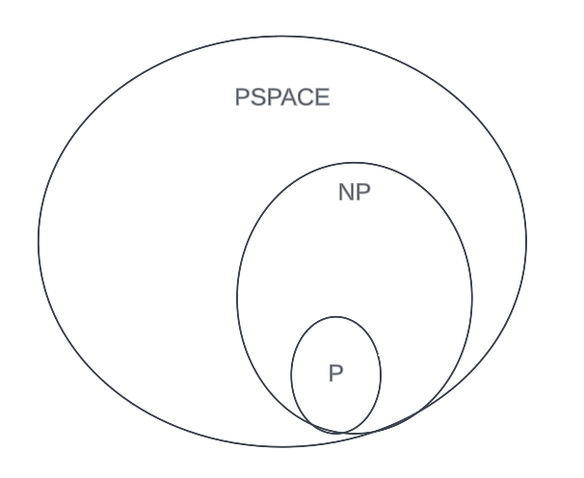
Class PSPACE
The complexity of an algorithm is commonly based on the input size and is most often defined by its efficiency, but not always.
PSPACE (Polynomial-Space)
: the class of problems solvable in polynomial space, but unlimited time
Question: Why does PSPACE encapsulate everything?
Notes:
Answer: accessing memory = 1 unit of time; can't access more than poly in poly-running time.

Slide 6
Probabilistic Computing vs. Deterministic Computing
Deterministic Classical Computing
Deterministic
: given an input to a function/program/algorithm, you can be certain of the output
Classical
: refers to an object being governed by Newtonian physics
Probabilistic Classical Computing
Similar to deterministic algorithms, only now we have access to a source of perfect randomness
Think of a Turing machine with a built-in coin flipper
Notes:
Quantum computing uses a probabilistic approach, not deterministic.

Slide 7
Probabilistic Computing vs. Deterministic Computing
Questions:
Why would anyone use a program that has a chance to be wrong? Why does probabilistic computing work?
Example:
Imagine you have a probabilistic algorithm that, when run, has a ⅓ chance to provide the wrong solution. Running it once will only make you right ⅔ of the time. What could you do to better your odds of getting the correct result?
Answer:
Run the algorithm a few hundred times and take the majority answer!
Chernoff Bound
: you will be wrong with a probability that decreases exponentially with the number of trials run.
Demonstration via Python script
Notes:
Run “chernoff.py” and provide a number of trials.
Start with a small amount, like 5, and run it many times to show how the results vary (making the answer uncertain).
Then, run with larger amounts (1,000, 10,000, 100,000, etc.) and show how the results vary much less (~66%), meaning that you can be more certain of the results.
In essence, you are unsure what the chances are of getting certain outcomes when you only run a few trials; you must run many.
The chance of being wrong is incredibly small at this point.

Slide 8
Normalization Constraint
Normalization Constraint
: Given any number of events, the total of adding all event probabilities together should equal 100%. In other words, for x total events,
Example: There is a red, green, and blue ball in a hat and you must blindly take one out. The probability of getting the red ball would be ⅓, as would your chances of getting the green and blue balls. Overall, the probability of grabbing any ball is ⅓ + ⅓ + ⅓ = 1.

Slide 9
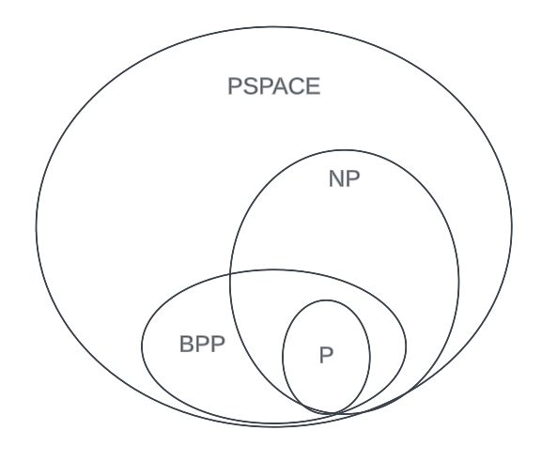
Class BPP
BPP (Bounded-Error Probabilistic Polynomial-Time)
: the class of decision problems for which there exists a polynomial-time randomized algorithm that accepts with probability greater than ⅔ if yes, or less than ⅓ if no.
Question: Why are all problems in P also in BPP?
The Sipser-Lautemann theorem states that if P=NP, then P=BPP
Notes:
⅔ is any constant greater than ½ .
⅓ is any constant less than ½ .
Answer: both solve in P time and any problem in P can add randomness and not use it.
The remaining problems in BPP are not known. Most have been derandomized into P.

Slide 10
Introduction to the Quantum Bit

Slide 11
Classical Bit vs. Quantum Bit
A classical bit is deterministic.
Example 1: fill out the NOT gate truth table below.
A quantum bit (qubit) is probabilistic.
Example 2: fill out the Coin-Flip gate truth table below.
Input | Output
0 | 1
1 | 0
Input | Output
0 | 50%
1 | 50%
Notes:
We don't know the value of the output until we measure it, similar to flipping a coin.

Slide 12
Born’s Rule
Probability Amplitude
: A complex number in quantum mechanics used to describe the likelihood of an event occuring (different that a standard percentage)
Born's Rule
: The probability of any given event occurring = |probability amplitude of event|²
Example: Given an event has a probability amplitude of ½, what is the probability of the event occurring?
Exercise: What is the probability amplitude associated with 75%?

Slide 13
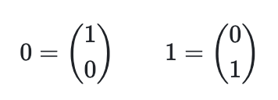
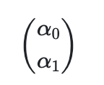
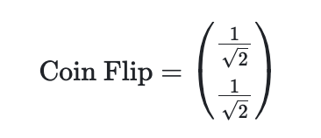
Column Vector for a Single Qubit
Classical bits store one value: 0 or 1
Quantum bits need to store two values: probability amplitudes of being 0 and 1
The general form of a single qubit is
where 𝛼₀ is the probability amplitude associated with state 0 and 𝛼₁ is is the probability amplitude associated with state 1
The basis states 0 and 1 in column vector form:
Example: the result of performing a coin flip can be represented by the following qubit in column vector form:
Exercise: draw the state of a qubit with a 25% chance of being measured as a 0 and a 75% chance of being measured as a 1.
Notes:
Do the example on the board before showing the answer.

Slide 14
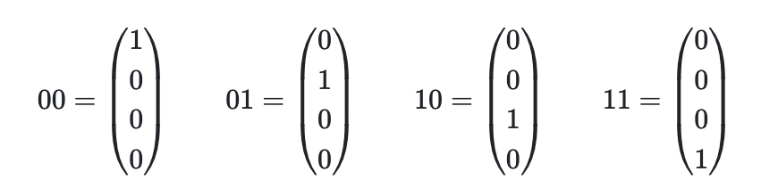
Column Vector for Multiple Qubits
For computation to be useful, we must use multiple bits rather than one.
The size and contents of a qubit's (or group of qubits') column vector corresponds with binary:
2^{(number of qubits)}
1 Qubit : column vector size = 2¹
2 Qubits : column vector size = 2²
Notes:
You need an entry for every binary combination of bits;
Explain the column vectors starting at 00 and going down to 11

Slide 15
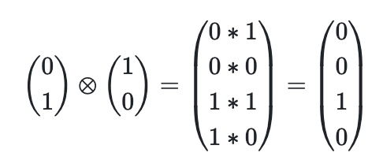
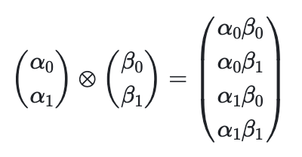
Column Vector for Multiple Qubits
Given two qubits 𝛼 and 𝛽, the general form of the combined state of both qubits can be represented like so:
Example: given a qubit in state 1 and another qubit in state 0, what is their combined state?
Exercise: if a single qubit can be used to represent a coin flip, then find the combined state that represents the result of flipping two coins.
Question: why do you think that column vector form isn't used in practice?
Notes:
The operation is called tensor product, but won't be discussed.
In essence, take every possible combination of the 2 qubits to form the new column vector.
Example: notice how the answer correlates with 10 because the first qubit was 1 and the second was 0.
Answer: too many zeros; the size of the column vector grows exponentially with the number of qubits.

Slide 16
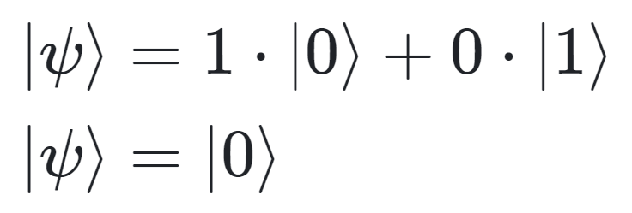
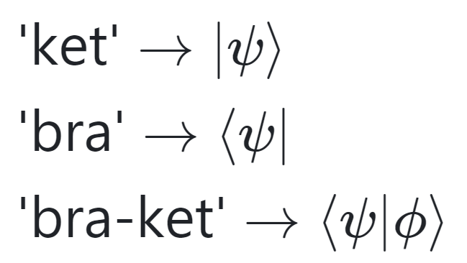
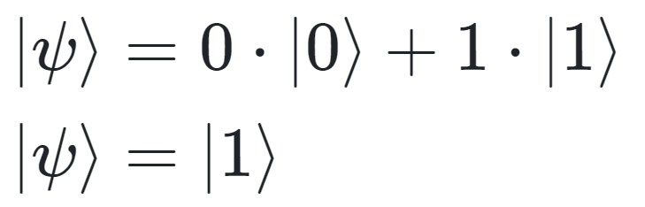
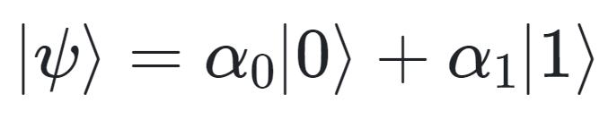
Dirac Notation for One Qubit
Dirac Notation is also known as “bra-ket” notation:
General form:
where 𝛼0 and 𝛼1 are the probability amplitudes associated with states 0 and 1 respectively.
State 0:
State 1:
Exercise: write the coin flip state in Dirac notation.
Notes:
Dirac notation follows the rules of algebra for the most part

Slide 17

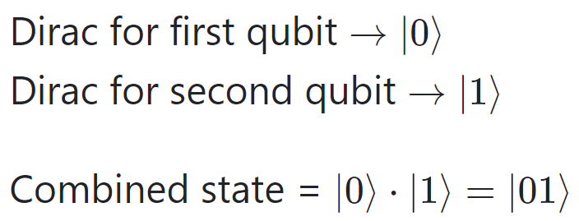
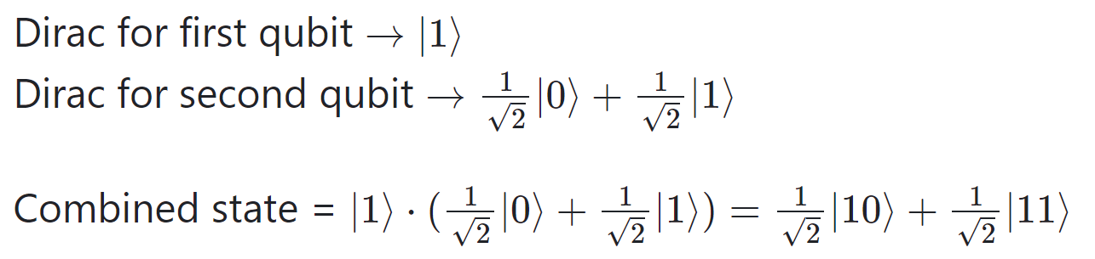
Dirac Notation for Multiple Qubits
Making the general form:
General form:
Exercise: Find the combined state in Dirac notation of two qubits, both of which are in the coin-flip state.
Question: Why do you think that this notation is prefered over column vectors?
Example 1: Find the combined state in Dirac notation of two qubits: the first is in state 0 and the second is in state 1.
Example 2: Find the combined state in Dirac notation of two qubits: the first is in state 1 and the second is in the coin-flip state.
Notes:
To make the general form, we must combine the two qubits into one state with algebra. FOIL
The ket stays on the side it was multiplied into from.
Answer: because we only include non-zero probability amplitudes.

Slide 18
Quantum Gates

Slide 19



X Gate
The quantum equivalent of the classical NOT gate (a 1-qubit gate)
Classical Bits
Qubits
The X gate swaps the probability amplitudes associated with state 0 and 1 for a single qubit
Exercise:
What is the result of applying the X gate to the following:
What is the probability, when measuring the resulting qubit, of getting state 0? State 1?

Slide 20
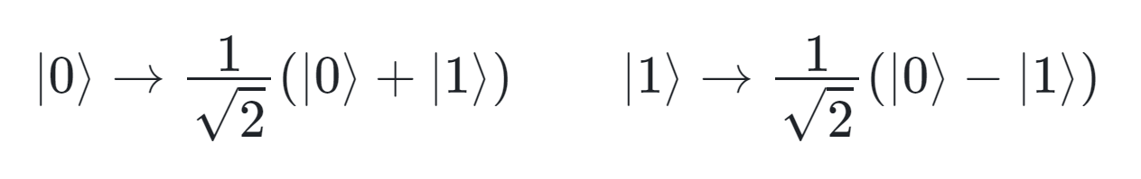
Hadamard Gate
Almost equivalent to the "coin flip" gate shown earlier (a 1-qubit gate)
The Hadamard gate mappings:
Exercise:
Apply the Hadamard gate to the first qubit in the following two-qubit state:
|𝜓〉 = |10〉
Notes:
The mappings are just you plugging in that for |0> or |1> rather than requiring only applying to a qubit in state 0 or 1.

Slide 21
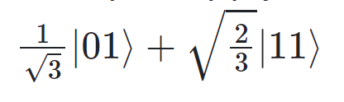
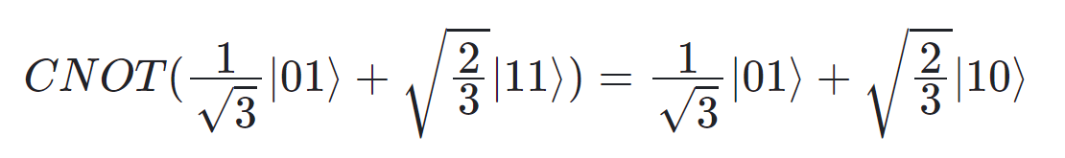
CNOT Gate
Like the X gate, only now the first qubit controls whether the second gets reversed
(a 2-qubit gate)
The CNOT gate mappings:
If the first bit (control bit) is 1, then apply the X gate to the second bit
The probability amplitudes remain unaffected
Example: Apply the CNOT gate to the qubits in the following state:
Exercise: Apply the CNOT gate to two qubits, one of which was in state 0 and is in the coin flip state and the other is in state 0.
Notes:
Show that, in the background, the probability amplitudes are just swapping by
applying CNOT to ½*|10> + 0*|11> using X rule of swapping amplitudes

Slide 22
Quantum Circuits and Complexity

Slide 23
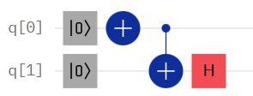
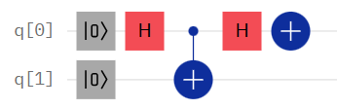
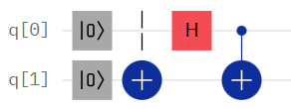
Properties of Circuits
Depth
: imagining each gate as taking up one time slice, but gates that could be executed together taking up a single time slice, the depth is the number of time slices in the circuit.
Space
: the total number of qubits (or wires) in the circuit.
Total Gates
: the total number of gates used in the circuit.
Exercise: for each of the following circuits...
Find the state of the computer at the end of the circuit.
Find the depth, space, and total gates.
Notes:
Walk through the first circuit together using |psi₁>, |psi₂>, etc.
Use Python script to demonstrate running the circuits.

Slide 24
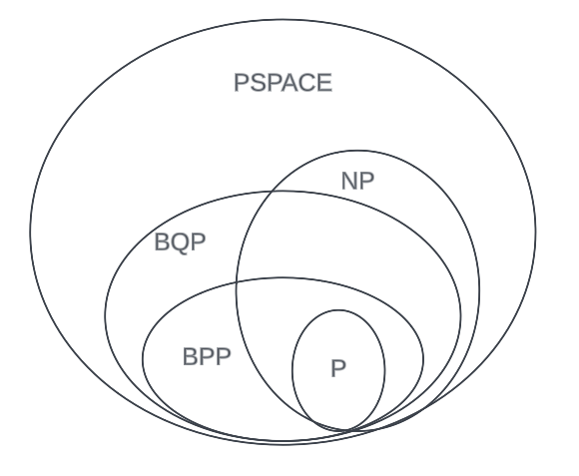
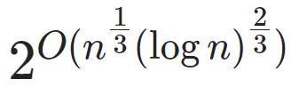
Class BQP
BQP (Bounded-Error Quantum Polynomial-Time)
: the class of decision problems for which there exists a polynomial-time quantum algorithm that accepts with probability greater than ⅔ if yes, or less than ⅓ if no.
BPP ⊆ BQP. Why?
A: Anything that can be done on a classical probabilistic computer can be done on a quantum computer.
A problem in BQP but not in BPP: integer factorization.
Problem statement: find an integer's prime factors.
Randomized time complexity:
Can be solved in quantum polynomial time.
Importance: multiplying two prime numbers is a key part of RSA encryption, so being able to factor a number into two primes is the first step to decrypt a message.
Notes:
Answer explanation: this is because Coin Flip = Hadamard gate.

Slide 25
Quantum Mechanics

Slide 26
Mach-Zehnder Interferometer Experiment (Part 1)
Legend
50%
A
__%
Photon Source
1
Beam Splitter
__%
B
50%
Detector
0
Exercise: what is the probability of a photon getting detected by Detector A? Detector B?

Slide 27
Mach-Zehnder Interferometer Experiment (Part 2)
Legend
__%
A
0%
Photon Source
1
Beam Splitter
100%
B
__%
0
Mirror
1
Detector
0
Exercise: what is the probability of a photon getting detected by Detector A? Detector B?
Notes:
This is a demonstration of quantum superposition and interference.
Next, we will see the math behind this strange result.

Slide 28
Mach-Zehnder Interferometer Experiment (Part 3)
A
0%
1
H
B
100%
0
1
H
0
Exercise: apply the Hadamard gate twice to a qubit in state 0 and compare the results with that of the Mach-Zehnder Interferometer experiment.
Notes:
The beam splitters are really just Hadamard gates applied one after the other.
(Draw this circuit on the board)
(Have them do exercise)
The reasoning is this: once a qubit is in superposition, it is open to interference.
Notice how the |1> terms cancelled out because they interfered with each other.
Do the exercise on the board after giving the students time.

Slide 29
Quantum Superposition
Superposition
: when a quantum object is in multiple states simultaneously, it is said to be in a superposition of all of the states.
In quantum computing, superposition is one of the most important tools in a computation.
Superposition is simulated using the Hadamard gate.
Qubits store exponentially more information that a classical bit.
For reference, the number of classical bits required to represent a state on the 433 qubit IBM Osprey processor would exceed the number of atoms in the known universe.
Notes:
It is important because it allows for interference to occur (discussed next)
Why qubits store exponentially more than classical bits:
This is because a classical bit only represents one binary number whereas a qubit can represent all binary numbers with a certain number of digits through superposition.
Known atoms: 10^82
Osprey states: 2^433 = 10^130
We have been using superposition the whole lecture
Draw on the board a 2-qubit state to show superposition.

Slide 30
Quantum Interference
Quantum Interference
: the act of subatomic particles interacting with and influencing themselves or other particles while in superposition.
Types of Interference
Constructive Interference
: when two particle waves interact with and reinforce each other.
Destructive Interference
: when two particle waves cancel each other out.
Example: ripples in a pond from two stones.
½ |0〉 + ½ |0〉 = |0〉 (constructive)
½ |1〉 - ½ |1〉 = 0*|1〉 (destructive)
Notes:
Not all interference is bad!
Describe the pond-ripple analogy before providing the following examples for constructive and destructive.
Relate the example to the math from the double Hadamard.
Reference: https://www.google.com/url?q=https://www.techtarget.com/whatis/definition/quantum-interference&sa=D&source=editors&ust=1710094220805027&usg=AOvVaw2JTU5nkm6OOGS4PYGV3p58

Slide 31
Utilizing Quantum Interference
While quantum computing is probabilistic, the existence of interference allows for a more precise and predictable computation.
Quantum computing scientists who design quantum algorithms use interference to influence the outcome of the algorithm.
Analogy:
A line of coins representing the state of a computer.
Notes:
Analogy:
Flip all of the coins; when they are in the air spinning, they are in superposition.
You can use magnets (or the qubits themselves) to interfere with the qubits before they land, influencing the result.
This is what quantum computational scientists do: they leverage quantum interference to skew the results towards what they want. It amplifies some results and suppresses others.

Slide 32
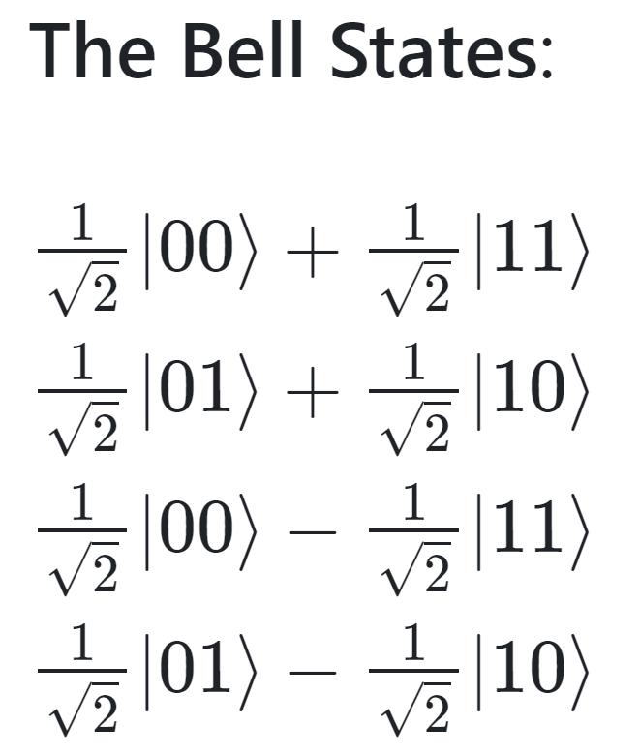

Quantum Entanglement
Entanglement
: a phenomenon where two or more particles are linked together in a way that their quantum states cannot be described independently.
Example: the wishbone experiment.
Use cases:
Quantum teleportation
Quantum cryptography
Superdense coding
Notes:
Contrary to the experiment, the value of each entangled qubit is not determined when they are entangled, but when they are measured.
Bell states: measuring one qubit immediately collapses the other. Cannot be factored into individual qubits.
I won’t be going into the use cases because, frankly, they are quite hard for me to understand.

Slide 33
Classical Computers vs. Quantum Computers
Classical Computers
Classical processors use classical bits
Uses a fan to stay cool and avoid overheating
The state of the computer can be found by looking at the bits at any point during the computation
Quantum Computers
Quantum processors use qubits
Must stay at absolute zero
(−459.67 °F / colder than space)
The state of the computer must be found by measuring the qubits at the end of the computation

Slide 34
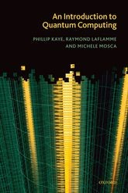
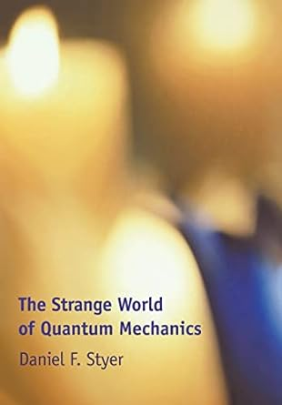
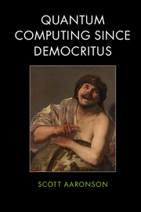
Resources
Python Quantum Computing Libraries
IBM: Qiskit
Google: Cirq
Microsoft: Azure QDK
Books
“An Introduction to Quantum Computing" by Phillip Kaye, Raymond Laflamme and Michele Mosca
"The Strange World of Quantum Mechanics" by Daniel F. Styer
"Quantum Computing Since Democritus" by Scott Aaronson

